Slide 1

SAMSUNG PRISM
Generative AI
Hackathon
3rd Edition 2026 – 27
Theme ID - 4
Team Name - MSRIT_dRAG
College Name - M S Ramaiah Institute of Technology
Member Name & Email 1- Harsh Gupta 1ms25cs062@msrit.edu
Member Name & Email 2- Ganesh Agarwal 1ms25cs057@msrit.edu
Member Name & Email 3- Ayush Singh 1ms25cs033@msrit.edu
Member Name & Email 4- Garvit Rathod 1ms25cs059@msrit.edu
Submission Github link - https://github.com/ganeshagarwal264/StreamRag

Slide 2
Theme
Conversational voice systems require incremental, real-time context.
Incremental Listening
Predicts retrieval intent before utterance finishes.
Multi-Intent Queries
Extracts distinct sub-questions from unsegmented streams.
Standard RAG pipelines fail to reflect natural human communication by imposing static, batch-oriented turns.
Late-Arriving Constraints
Refines answers mid-stream without discarding prior context.

Slide 3
Existing Solutions & Gaps
CONVENTIONAL QUERY-AT-A-TIME PIPELINE
Complete Query
Retrieve Docs
Generate Answer
End-of-Utterance Blocking
Compound Intent Failure
Waits for final utterance completion before initiating search.
Retrieves poorly when multiple distinct needs merge.
Destructive Refinement
Unsupported Hallucination
Late constraints force a complete pipeline restart.
Fabricates answers when corpus evidence is insufficient.

Slide 4
Our Solutions & Architecture Diagram
Streaming Input
[Token 1] → [Token 2] → Intent Stability Check
Retrieval Controller
WAIT
RETRIEVE
SUPPRESS
Decomposer & Fusion
Extracts sub-queries • Parallel corpus retrieval
Session Synthesis
Streaming Answer + Grounded Citations + Telemetry

Slide 5

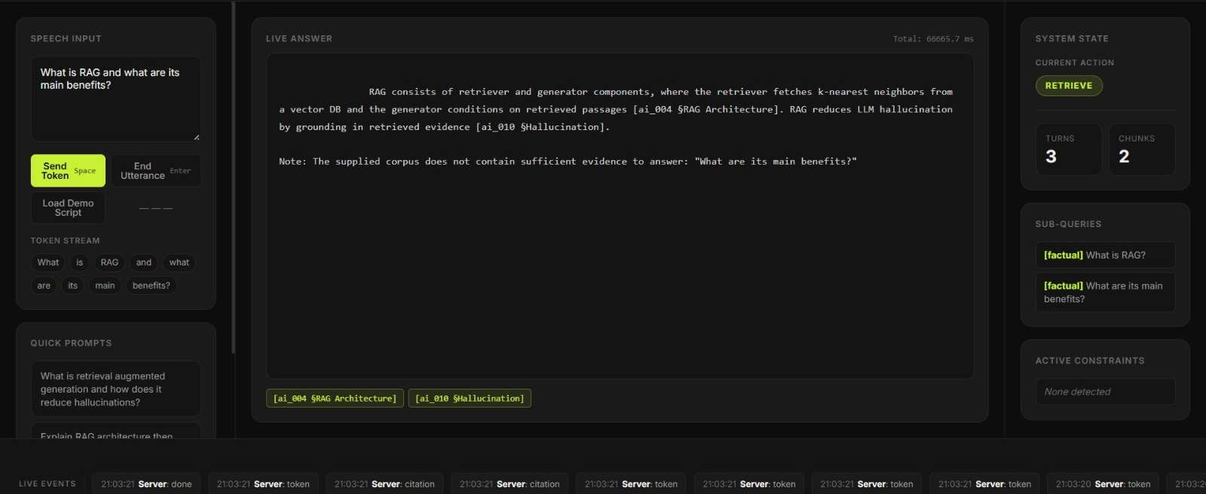

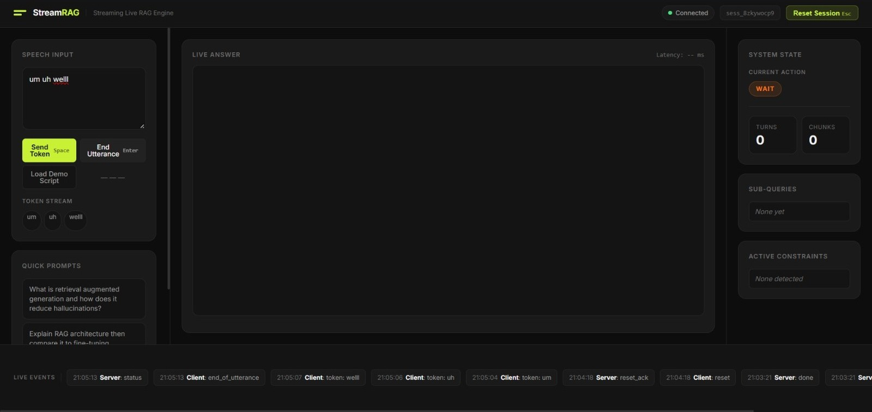

Our Solutions & Architecture Diagram
Multi-Intent & Grounding
Query: "What is RAG and what are its main benefits?"
Extracts two sub-queries. Answers first part with chunk citations.
Explicitly reports insufficient evidence for the unsupported sub-query.
WAIT State
SUPPRESS State
"um uh well"
No premature retrieval.
"next slide please"
Avoids wasted vector search.

Slide 6



Tools and tech stack used
Frontend
Backend
RAG Pipeline
LLM Engine
HTML / CSS / JS
Python 3
Chroma DB
Ollama
WebSocket Streaming
FastAPI
Hybrid Retrieval
Gemma 4 12B
Live Telemetry UI
Uvicorn Server
Session Management
Python Test Suite

Slide 7
Impact & Use case
Enabling responsive, hallucination-free interactions for voice-driven enterprise interfaces and real-time streaming assistants.
Meeting Assistants
Interactive Support
Cost Efficiency
Processes live transcripts incrementally as speakers form complex requests.
Handles real-time session refinement without restarting context.
Suppresses unnecessary vector searches during conversational filler.

Slide 8
Innovation highlights, results and limitations
Innovation Highlights
Verified Results
Limitations
Pre-utterance early retrieval
101/101
Dependent on corpus coverage.
WAIT / RETRIEVE / SUPPRESS
Automated tests passing
Strict parametric memory boundary.
Multi-intent decomposition
2/2
Local LLM inference latency.
Explicit insufficient-evidence
Session-aware refinement
Server responsive tests passing

Slide 9
What’s next
Evaluation Scale
Latency Reduction
Speech Integration
Broader and better-curated evaluation corpora benchmarks.
Improved retrieval/reranking and lower-latency inference.
Robust streaming speech and transcript integration.

Slide 10
Brownie points slide( differentiation)
"Retrieval is treated as a streaming control problem, not simply a final-step search."
Early retrieval before completion
Intent-based retrieval suppression
Multi-intent routing & decomposition
Session-aware late refinement
Grounded + Observable Streaming Answers

Slide 11
Checklist- Updated on Public GitHub
(YES )
Working prototype code — public or shared GitHub repo
README with reproducible setup instructions
(YES)
Demo video, max 5 minutes
(YES)
Presentation file (PPT or PDF)
(YES )

Slide 12
Thank you
Organised by the Language AI Team and the PRISM Team, Samsung R&D Institute India

